Slide 1


Sprint 4 – Triathlon Presentation
Maheen, Gina, James

Slide 2


Contents:
Challenges
Roles
Achievements
Demonstration

Slide 3
Challenges faced:
Robot was unpredictable.
Classroom was occupied during our free time.
Schedules did not match up.
Block code was difficult to perfect.

Slide 4
Roles of members:
Gina (Project Manager):
Carrying out project tasks.
Motivating members to do work.
Maheen (Project Planner and Programmer):
Planning project.
Setting up meetings.
Writing code.
James (Project Review):
Creating flowcharts.
Reviewing documents.

Slide 5
What we learned from this project:
Software engineering is a painstaking process that pays off in the end if done correctly.
If one step is incorrect, the entire code might be corrupted.
Little pieces of code can be stacked together to make a much stronger, greater, more powerful code.
There will be a great deal of trial and error, and you will need a great deal of patience.

Slide 6
What we would do differently in the sprints:
Structure our plan to execute each sprint better if we had to do it all over again.
Communicate better.
Share documents in a more convenient way like Google Docs, Slides, or Drive.

Slide 7
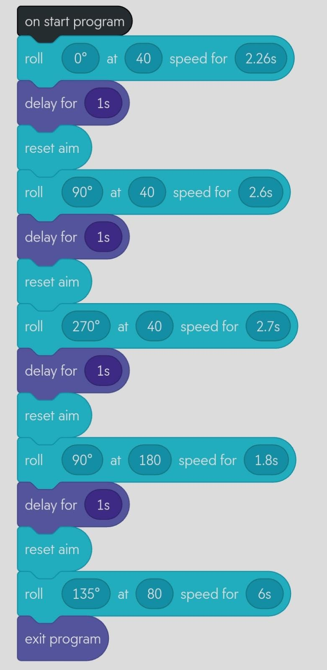
The block code we used for Sprint 3 – Agility:

Slide 8
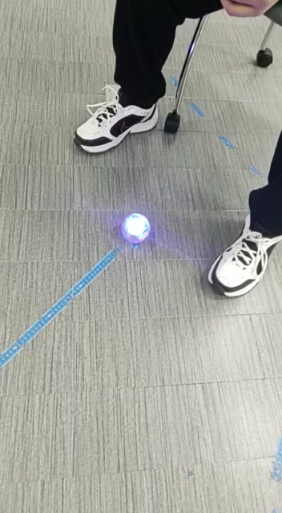
Video of the sprint:

